Slide 1


Slide 2

Make-A-Wish
1-is a nonprofit organization founded in the United States .
2- Established in April, 29,1980

Slide 3
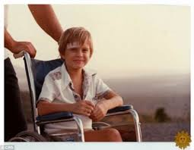
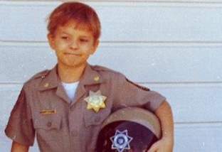
Christopher James Greicius
In the spring of 1980.
Being treated for leukemia.
He aspired to be a police officer.

Slide 4
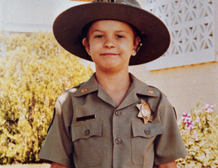
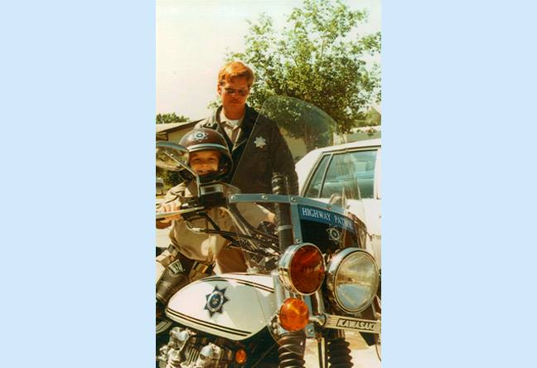
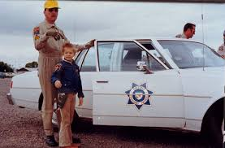
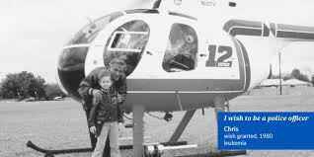
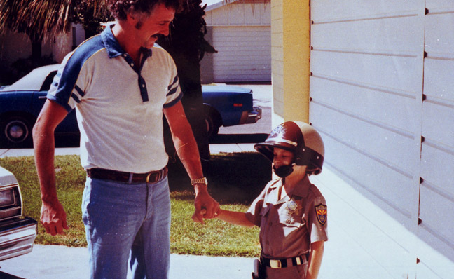
Tommy Austin
Befriended Chris and worked with officers at the Arizona Department of Public Safety .
Tommy was helped with other people: Jim Eaves and Frank Shankwits
.He became the inspiration for the Make-A-Wish organization.

Slide 5
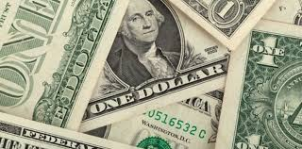
Grocery store manager
The first donation is $15.
The group receives its tax-exempt status as a non-profit organization.

Slide 6

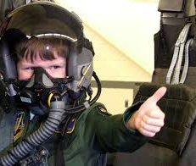
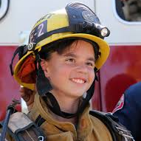
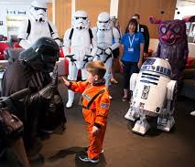
In 2019, more than 315,000 children in the United States. and its territories have benefited from the hope.

Slide 7
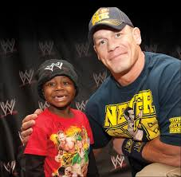
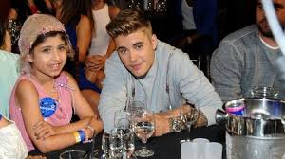
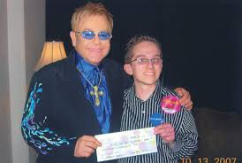
Make-A-Wish Foundation has received support from the following celebrities
Professional wrestler John Cena holds the title for the most wishes granted by a single individual, with over 600 wishes.
Singer Justin Bieber has volunteered in over 250 wishes

Slide 8
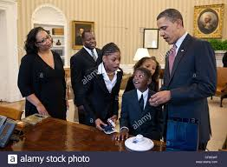
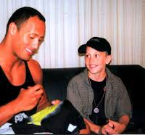
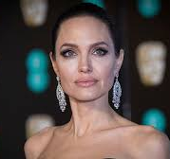
OTHER celebrities
Elton John, Bill Clinton, Annie Lennox, Paul McCartney, Bono, Sting, Lady Gaga, George Clooney, Angelina Jolie, Barack Obama, Prince Harry, Miley Cyrus, Sheryl Crow, Prince William, Alicia Keys, Justin Bieber, Sharon Stone.

Slide 9
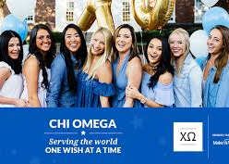
. National collegiate sorority Chi Omega
.Has raised over $20 million and has volunteered over 1 million hours of service for Make-A-Wish.

Slide 10
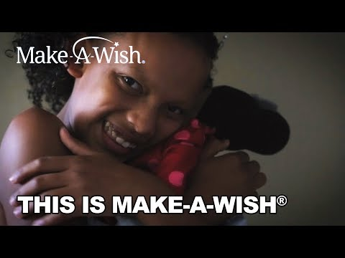

Slide 11


